Slide 1
SE 492 - Electronic Program of Study
sddec21-04
Team: Ellie Bair, Andrew Goluch, Lucas Bell-Steckel, Thomas Hotard, and Cavin Leeds

Slide 2
Problem Statement
Iowa State has coursework requirements each student must fulfill before they graduate.
Requirements can be confusing and overwhelming.
Every student in the Electrical and Computer Engineering Department (including Software and Cyber Security Engineering majors) needs to create a Program of Study (POS) in their orientation course.
These programs are checked by hand, taking enormous amounts of time and leaving room for mistakes to be made. Mistakes overlooked can throw off student progress and discourage achievement.
Advisors need a solution, an Electronic Program of Study.
Notes:
Thomas

Slide 3
Design
The electronic program of study is a web application fulfilling all the requirements of the previous program of study assignments.
Two primary users, Advisors and Students. Advisors use the app to view student’s program and provide feedback, suggestions, and cut down on time used to check.
Students use the program much like the traditional method by adding courses to semesters until all requirements are met. The app checks the document for missing required courses and tells which courses are not required but on the schedule. Students receive instructor feedback and communication.
Notes:
Thomas

Slide 4
Software and Technology Platforms
Frontend Technologies
Javascript is used as our only front end language working in conjunction with backend python to bring relevant database information
Django framework is used to easily bring in and format information from database for use with javascript code
Backend Technologies
Python is used as our main back end language to handle the moving of information between our database and frontend
Django is used as a backend framework for creating and modifying the database and relations
SQLite is used for our database as Django’s default
The login is also handled by Django’s login
Notes:
Thomas Front End Technologies
Lucas Back End Technologies

Slide 5
Server
There were many hiccups and obstacles in setting up the server and getting the web application running on the server.
The First Server
The Second Server
The Final Server
Notes:
Lucas.

Slide 6
Data Importing
No database of courses provided
Python web-scraper was developed to be a workaround
Successfully got most information for 8000+ courses
Prerequisites were ignored due to difficulty with inconsistencies
Notes:
Cavin

Slide 7
Database
The database has 4 models:
Student: first name, last name, email, classes, etc
Advisor: first name, last name, email, students, etc
Class: major, name, credits, description, etc
Degree: name, classes, pick class
Notes:
William

Slide 8
API
Django queries, forms, built-in template tags, and filters
Getting class, student, advisor, and degree data
Register account
Login
Django REST framework
Getting student by id
Updating student by id
Notes:
William

Slide 9
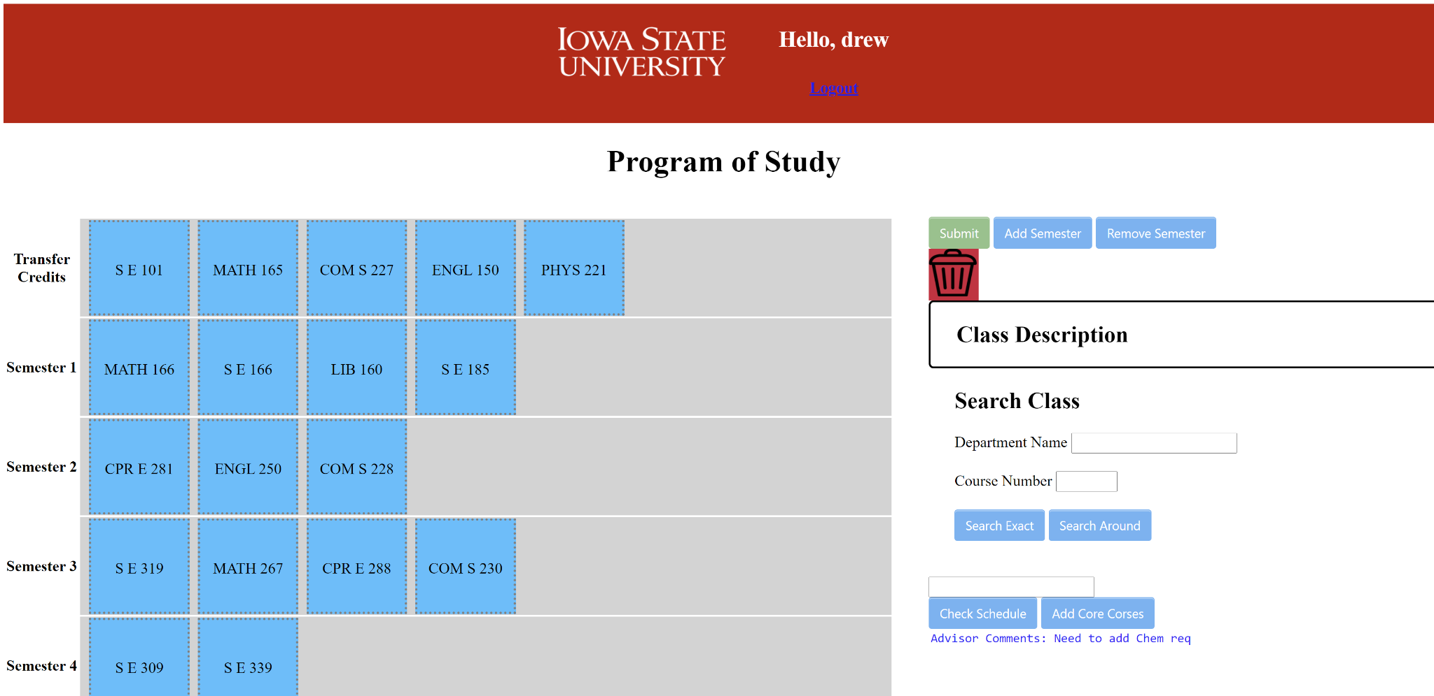
Schedule Builder

Slide 10
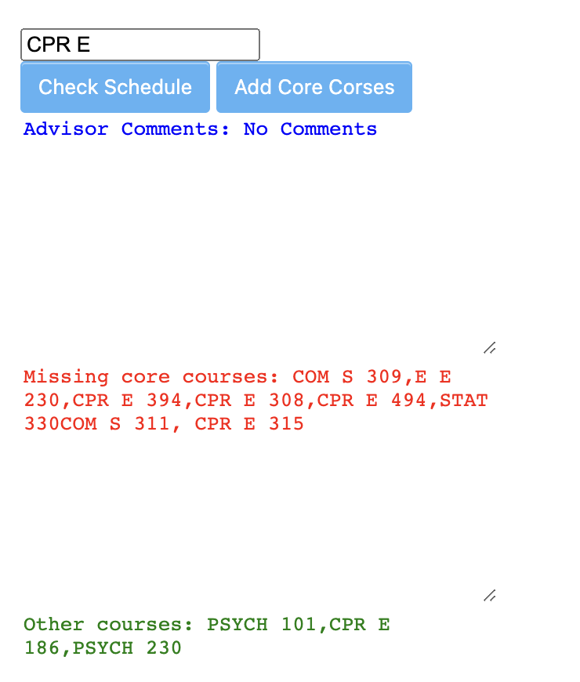
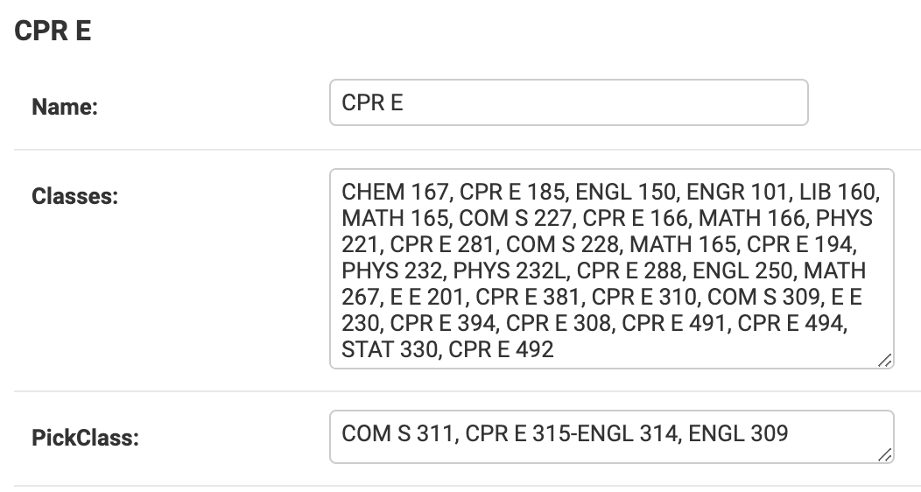
Schedule Checker
Degree in database-
Notes:
The program checker and validator is there to check

Slide 11
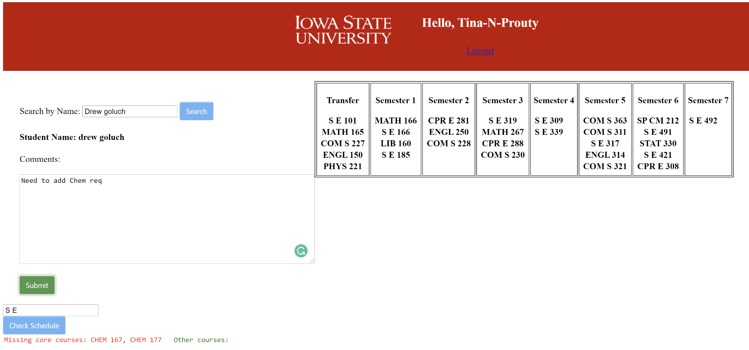
Advisor Side

Slide 12
Conclusion
Many challenges overcome, including major life events in the team
Learned a lot including new languages, framework, teamwork, and communication
Working virtually was difficult but we’re proud of what we were able accomplish with this project
We see this as an opportunity for future senior design teams to build upon

