Slide 1
CprE/SE 491 Final Presentation
Electronic Program of Study Form
SDDEC21-04
Advisor: Maruf Ahamed
Client: Tina Prouty
Students: Andrew Goluch, Elisabeth Bair, Lucas Bell-Steckel, William Peng, Cavin Leeds, Thomas Hotard
sddec21-04.sd.ece.iastate.edu
Notes:
“Advices on presentation” https://canvas.iastate.edu/courses/78273/files/15219480?module_item_id=3603012

Slide 2
Project Plan

Slide 3
Problem Statement
Iowa State has coursework requirements each student must fulfill before they graduate.
Requirements can be confusing and overwhelming.
Every student in the Electrical and Computer Engineering Department (including Software and Cyber Security Engineering majors) needs to create a Program of Study (POS) in their orientation course.
These programs are checked by hand, taking enormous amounts of time and leaving room for mistakes to be made. Mistakes overlooked can throw off student progress and discourage achievement.
Advisors need a solution, an Electronic Program of Study.
Notes:
Thomas

Slide 4
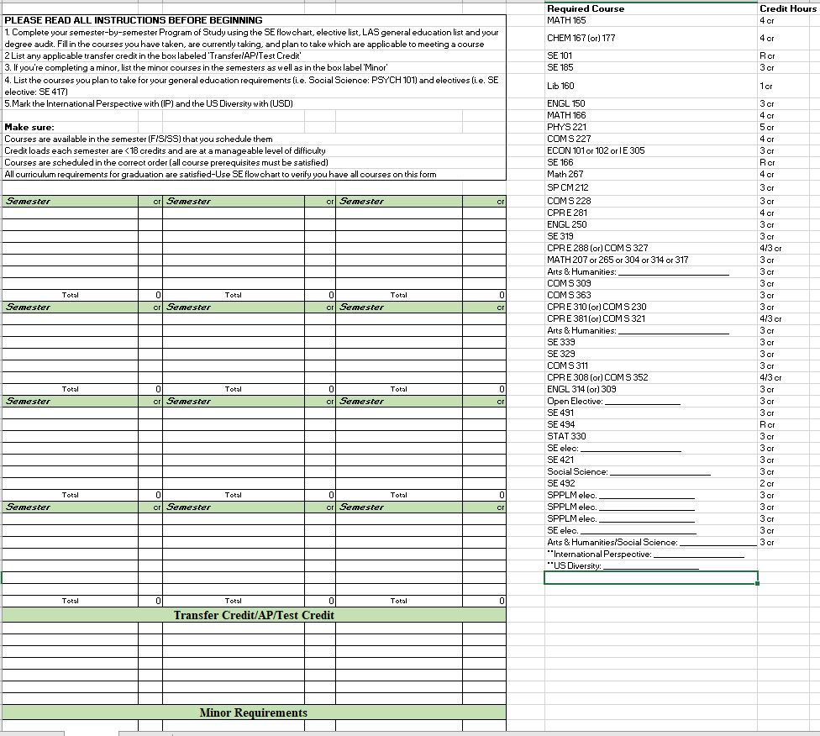
Notes:
Thomas

Slide 5
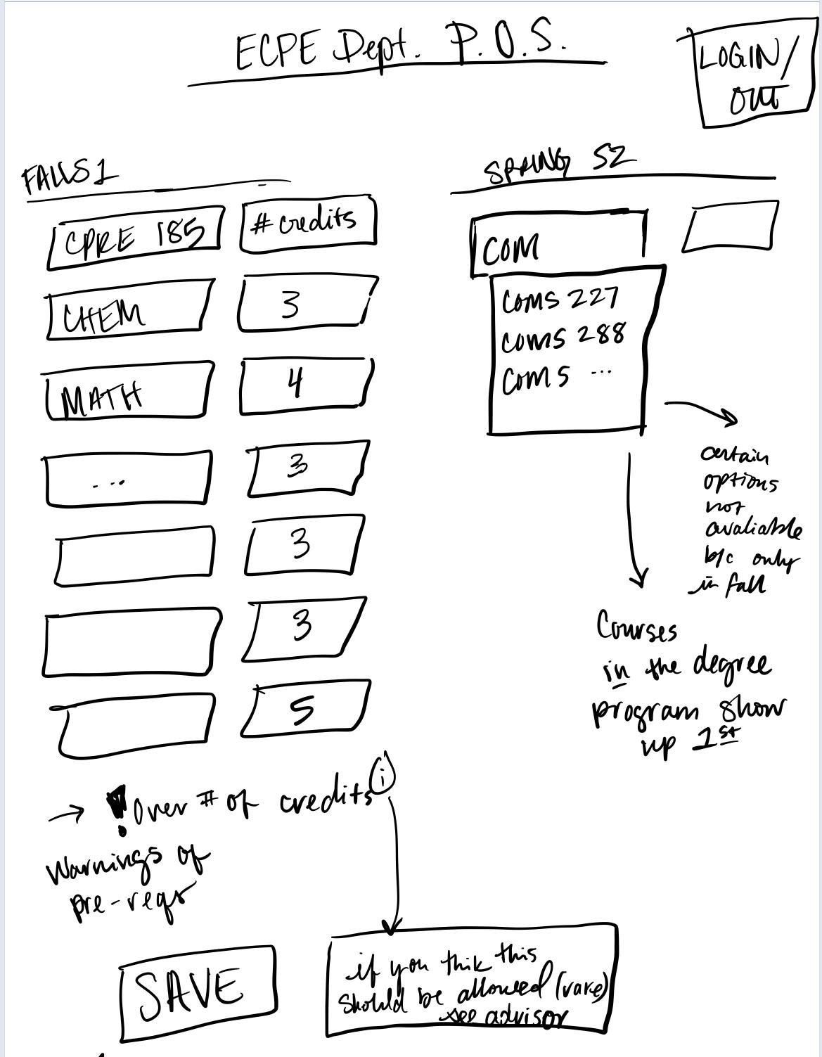
Conceptual Sketch
The electronic POS will be a web application fulfilling all the requirements of the previous Program of Study assignments.
Two users, Advisors and Students. Advisors use the app to view student’s POS and provide feedback, suggestions, and approve exceptions.
Students use the program much like the traditional POS by adding courses to semesters until all requirements are met. The web app checks the document for errors such as missing prerequisites or required courses. Students receive instructor feedback and communication.
Notes:
Thomas

Slide 6
Functional Requirements
Login using @iastate email
Creation of POS for Electrical, Computer, Software, and Cyber Security Engineering majors and their current respective requirements and courses
Give warnings for missing classes or courses added without co- or pre-requisites.
Advisors can add new classes/requirements to the program
Classes are able to be labeled as required, based on a given catalog year
Students can request and advisors can approve exceptions
Advisors can give feedback
Notes:
Thomas

Slide 7
Non-functional requirements
Usable on commonly used internet browsers
Application is maintainable and will run smoothly for the foreseeable future
Application should be capable enough to handle hundreds of users at once and thousands of users over time
Application does not store users’ personal information/credentials, and will use existing frameworks to handle information and security
Notes:
Thomas

Slide 8
Technical Considerations
 | Advantage | Disadvantage
Web Application | Advisors will be able to easily view the POS of their assigned students | Need internet connection.
Mobile Application | Every student has a mobile device. | Can not require a student to have a mobile device. At least 2 versions: Apple and android.
Desktop Application | All Iowa State Students have access to computers through labs and laptop loaner programs | At least a version of Windows, macOS, and Linux.
Canvas Plugin | Students are familiar to Canvas | Not familiar with developing tools for Canvas.
Notes:
Lucas

Slide 9
Market Survey
Our project will have a lasting impact on both students and advisors here at ISU ECpE/SE/Cyber-security departments
ISU advisors will have a noticeable difference in their efficiency of accepting and grading of this infamous assignment
Students will spend less time and experience less stress on a historically time consuming and confusing assignment
This project will make an immediate difference on our campus, in our own departments
Notes:
Thomas

Slide 10
Risks and Mitigation
Late delivery of software:
Set an earlier deadline than the final deadline to have some flexible time for accidents.
Technology will not meet expectations:
Decide 1 or 2 more alternative technology at the beginning to use if the original decision does not meet expectations.
Changes in requirements:
Implement a modular design so it is easier to add or remove functions.
Less reuse than planned:
When finished planning, ask the advisor for advice.
Deviation from software engineering standards:
Check if our code is still valid to the standards every week.
Poor commenting of source code:
Make sure to comment the code before pushing the code to Git.
Notes:
William Peng

Slide 11
Resources and Cost Estimate
Git repository.
Working code editors.
Database software: MySQL.
Server costs in the long term.
Development subscriptions (if our current tools are found to be insufficient).
Overall, only costs for development/deployment should be the server costs to handle the application in the long term.
Notes:
William Peng

Slide 12
Project Milestones and Schedule
Get all requirements from client April 7th
Develop a project plan April 21st
Setup the database for one program August 29th
Create a simple user interface September 5th
Setup the database for two more program September 5th
Create a more user friendly interface September 19th
Have a prototype of the project October 18th
Complete project December 5th
Notes:
William Peng

Slide 13
Project Milestones and Schedule (contd)
Notes:
William Peng

Slide 14
System Design

Slide 15
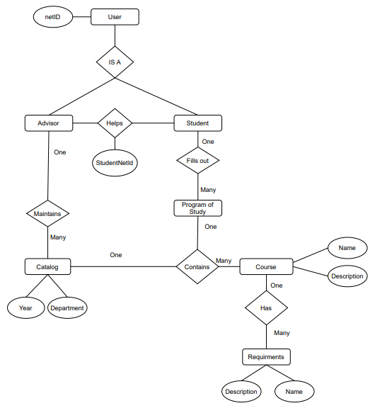
Detailed Design
Developed an Entity-Relationship Diagram for the main database components
Notes:
Lucas

Slide 16
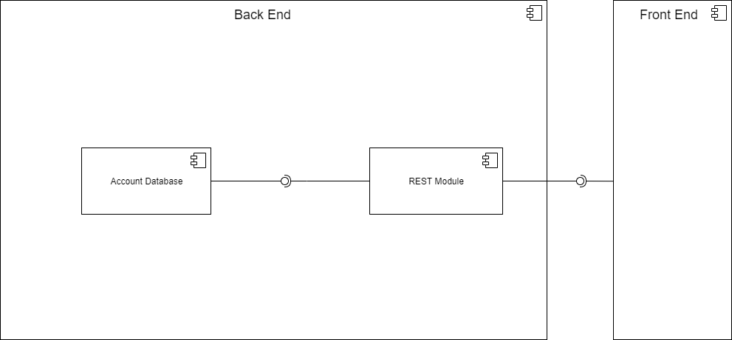
Detailed Design - Functional Decomposition
Notes:
Lucas

Slide 17
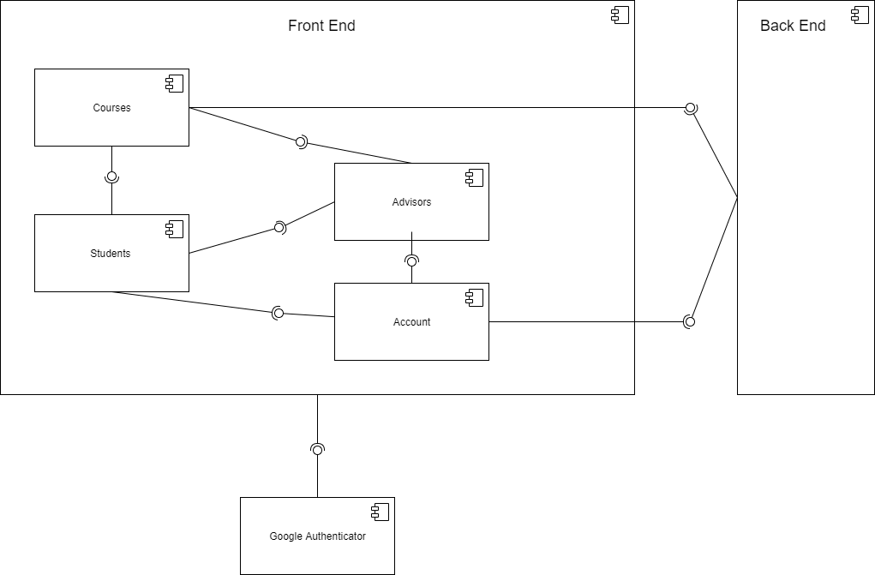
Detailed Design - Functional Decomposition
Notes:
Lucas

Slide 18
Software and Technology Platforms
Front End Technologies
Javascript will be used as our main front end language unless the need arises to include another
Event handling logic will be assisted through the use of jQuery javascript library
Ajax library will be used to create a more interactive/easy to use UI
Back End Technologies
Python will be used as our main back end language to handle the moving of information between our database and front end
MySQL will be used as our database technology due to our familiarity and experience with the technology
The Flask library will be used to help utilize Google’s existing login APIs
UFW will be used for the firewall on our server
Notes:
Drew Front End Technologies
Lucas Back End Technologies

Slide 19
Testing Framework
Most of the testing will be through Selenium.
Acceptance testing
Functional testing
CI/CD
Manual testing
We will give the application to one of the 166 courses
GUI testing based on student and instructor feedback
Will be able to stress test with ~100 simultaneous users
Notes:
Cavin

Slide 20
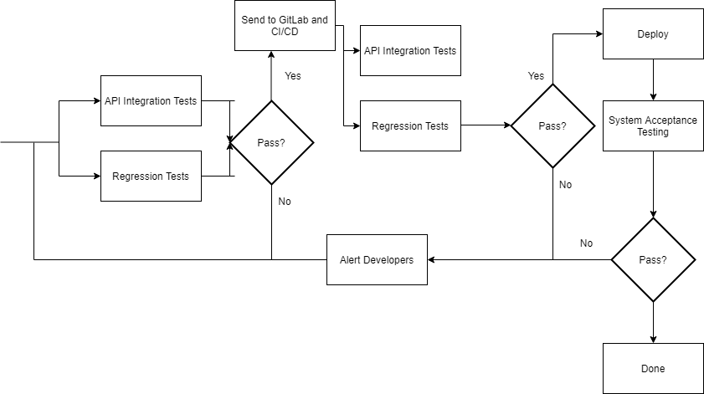
Test Plan
Notes:
Cavin

Slide 21
Test Cases
If a student can search the courses they need.
If the frontend can pass the user’s schedule to the backend after saving.
If a prerequisite does not meet, an alert will show which course is it.
If the comments from the advisors can be shown correctly on the students side.
If the advisor can approve exceptions to the rules.
If the schedule created is missing courses to complete the degree, an alert will show which courses are missing.
If advisors can edit, create, and delete courses, catalog rules and degree programs
Notes:
Cavin

Slide 22
Prototypes
We developed a series of mock up designs
Backend
Created a basic version of the database
Frontend
Development of GUI prototypes based on feedback from the client
Images are available on the website under project documentation
Notes:
Andrew

Slide 23
Notes:
William Peng

Slide 25
Notes:
Andrew

Slide 26
Notes:
Andrew

Slide 27
Notes:
Andrew

Slide 28
Conclusion

Slide 29
Current Project Status (relate to milestones)
Our team has completed talking to the clients and finished the designing the project plan.
We are currently designing the prototype of our project.
Everything is on schedule by the submission of the project plan.
Notes:
Cavin

Slide 30
Contributions of each project member
Andrew Goluch Front End Lead Focused on Design Document section 3 and 5 Updated website Created mockup GUI elements | Lucas Bell-Steckel Back End Lead Focused on Design Document section 3 Created backend infrastructure | William Peng Full Stack Coordinator Focused on Design Document section 2 Updated website Created a mockup GUI element
Thomas Hotard Report Manager Focused on Design Document section 1 and 2 Developed a majority of the presentation | Cavin Leeds Test Engineer Focused on Design Document section 4 | Elisabeth Bair Meeting Coordinator Focused on Design Document section 1 and 6 Lead group in all meetings
Notes:
All if under 20 min

Slide 31
Plan Moving Forward
Summer 2021
Focus on some of the more repetitive tasks
Filling the large course database
Work won’t be required but team members are welcome to do what they can
Fall 2021
Begin the semester with a team, client, and advisor meeting
Notes:
Cavin

Slide 32
Thank You!

